Slide 1
3D Graphics and Animation
Basic Matrix and 2D Transformation

Slide 2
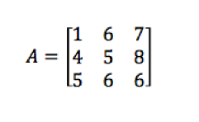
Introduction to Matrix
A rectangular array of numbers, symbols, or expressions, arranged in rows and columns.
A 3x3 matrix

Slide 3
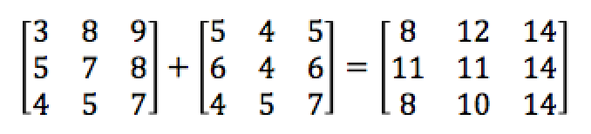
Matrix Addition
Can only add matrix of the same size.
Each each element from the first matrix to the corresponding element of the second matrix.

Slide 4
Matrix and Translation
An addition operation
Consider a triangle with the following three points
(0,0) (0,2)(2,2)
We want to translate the triangle – move to right by 3 units (x axis) and move down by 4 units (y axis).

Slide 5

Matrix and Translation
An addition operation
We can only add matrix of the same size.
So we need to construct the translation matrix using the same pair value 3 times.

Slide 6
Matrix Multiplication
Consider two matrix of size nxm and mxp
First matrix has n row and m column (nxm)
Second matrix has m rows and n column (mxp)
You can multiply two matrices if, and only if, the number of columns in the first matrix equals the number of rows in the second matrix.
So we can multiply nxm and mxp
The result will be a nxp matrix

Slide 7


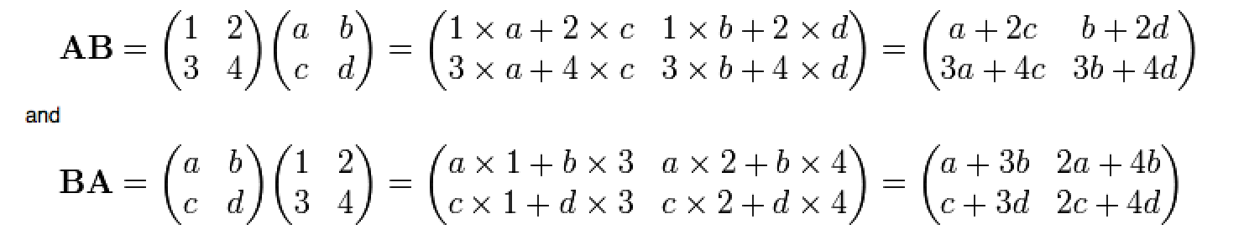
Matrix Multiplication

Slide 8
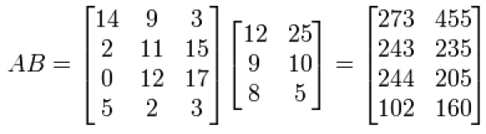
Matrix Multiplication

Slide 9


Matrix and Translation
Instead of using addition, we can use multiplication to perform
Translation for each point.
Need to add an additional 1 to the point matrix so that it can be multiplied.

Slide 10
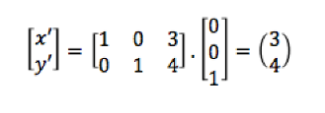
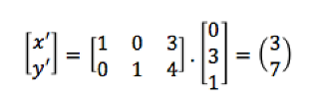
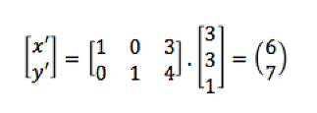
Matrix and Translation
Using the previous example, use matrix multiplication to work out the new points

Slide 11


Matrix and Rotation
We can ignore the last equation

Slide 12
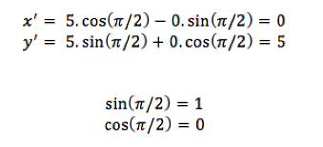
Matrix and Rotation
Consider the point (5,0), we rotate it by 90º or by π/2 radian
(5,0)
(0,5)

Slide 13
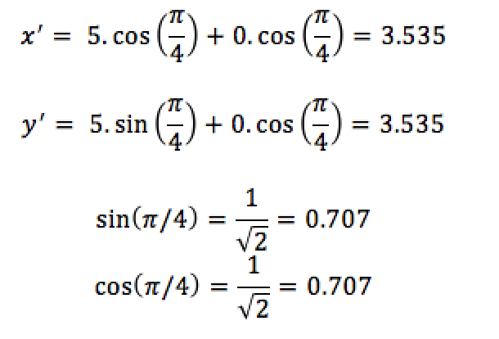
Matrix and Rotation
Consider the point (5,0), we rotate it by 45º or by π/4 radian
(5,0)
(3.535,3.535)

Slide 14
Pixel and resolution
It is not possible to display the point 3.535 pixel on screen.
Pixel is in discrete measurement
The point (3.535,3.535) is approximated to point (4,4)
(5,0)
(4,4)

Slide 15
Sine value
Sine(x) = Opposite/hypotenuse
SOH
Sin(45) = 1/√2
45º
√2
1
45º
1

Slide 16
Cosine value
Cosin(x) = Adjacent/hypotenuse
CAH
Cos(45) = 1/√2
45º
√2
1
45º
1

Slide 17
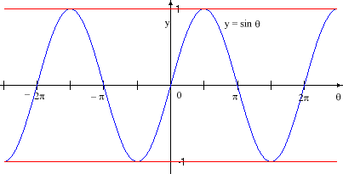
Sine function
Starts from 0
Hit first peak at π/2
Going down to 0 at π
Hit first lowest peak at 3π/2
Going down to 0 at 2π
Cycles continues…

Slide 18
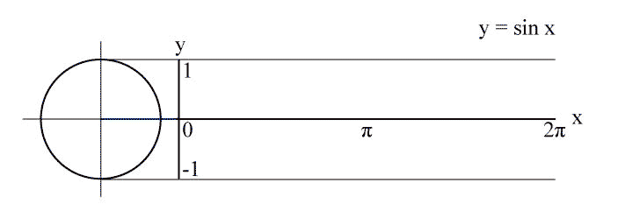
Sine and circle
http://en.wikipedia.org/wiki/File:Sin_drawing_process.gif
View the image at the URL for the animation

Slide 19
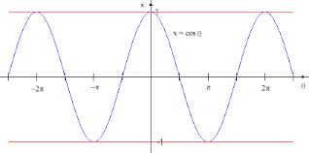
Cosine function
Similar to sine
Starts from 1 instead of 0
A phase shift of π

Slide 20
Recap - Translation

Slide 21

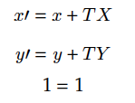
3x3 Translation Matrices
If we want to combine operations such as translation, rotation and scaling, by the operations of addition and multiplication. All related matrices need to have equal numbers of columns and rows.
To change the translation into a 3x3 matrices. We can convert to the following

Slide 22
Recap - Rotation

Slide 23
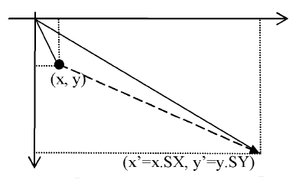
Scaling
Multiplication of the x component value by some factor SX and of the y component value by some factor SY .

Slide 24

Scaling

Slide 25
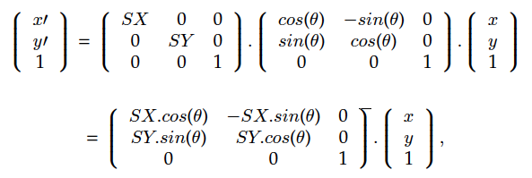
Combination of transformations
Rotation and then scaling of a point

Slide 26
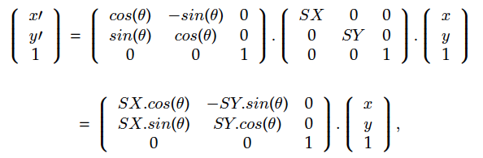
Combination of transformations
Scaling and then rotation of a point
matrix multiplication is not commutative.
i.e. A.B not equal to B.A

Slide 27

Rotation about a general point
Rotation about some general point (x0, y0) can be achieved by
Translating the point to the origin
carrying out the rotation at the original
Translating the point back to its original position

Slide 28
Exercise
Given Θ=π/2 Sx = 2 Sy = 3 P=(2 1 1)
Find R.S.P
Find S.R.P
Θ=π/3 Tx = 3 Ty = 1 P=(1 3 1)
Find R.T.P
Find T.R.P
https://www.symbolab.com/

Slide 29
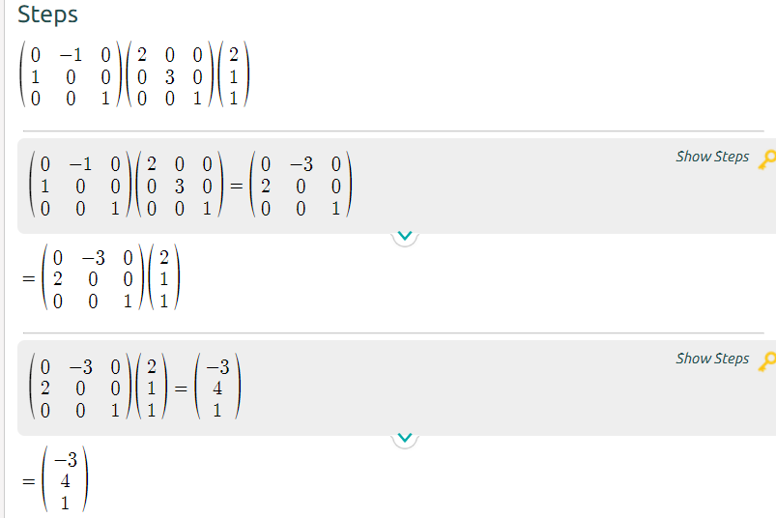
Given Θ=π/2 Sx = 2 Sy = 3 P=(2 1 1) Find R.S.P
Cos(π/2) = 0
Sin(π/2 ) = 1

Slide 30
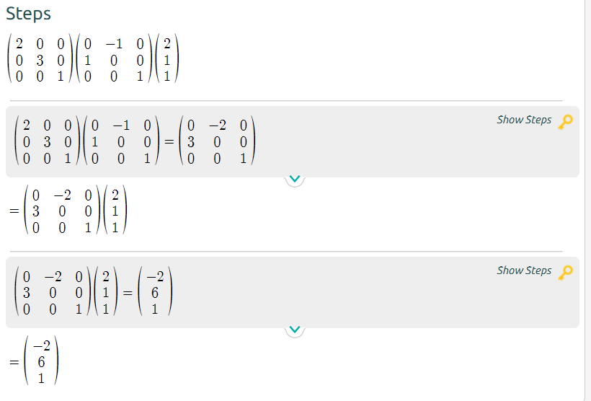
Given Θ=π/2 Sx = 2 Sy = 3 P=(2 1 1) Find S.R.P
Cos(π/2) = 0
Sin(π/2 ) = 1

Slide 31
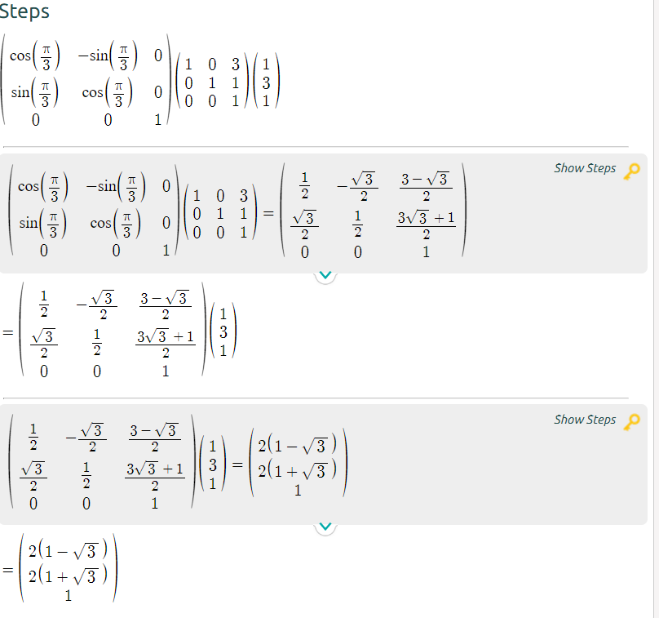
Θ=π/3 Tx = 3 Ty = 1 P=(1 3 1) Find R.T.P
Sin(π/3) = 0.866
Cos(π/3)=0.5

Slide 32
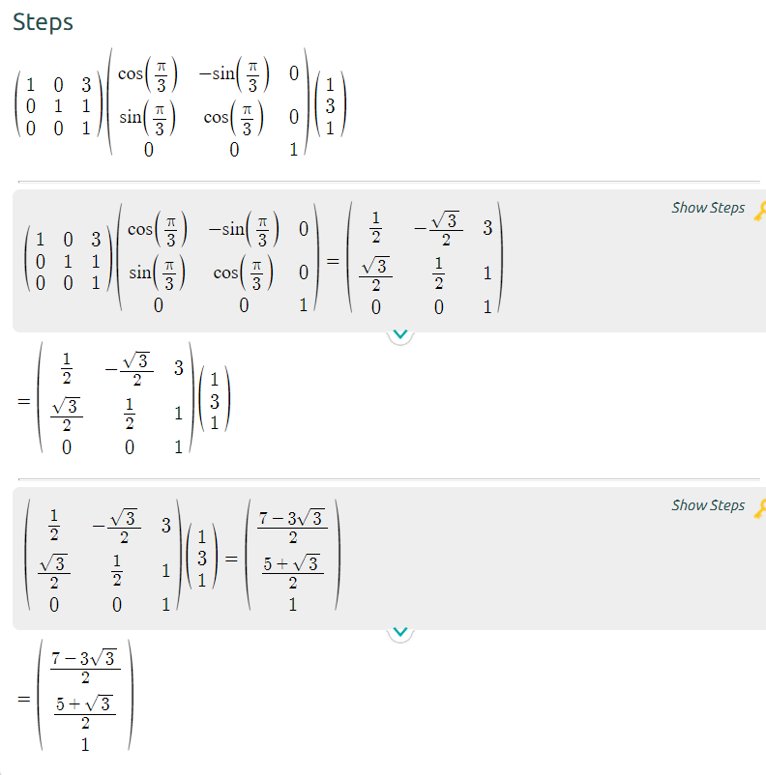
Θ=π/3 Tx = 3 Ty = 1 P=(1 3 1) Find T.R.P

